Slide 1



Predictive Irrigation System ( Irrigo )
Vertex Innovate
Dheeraj Patnaik
Mohammad Shahnawaz

Slide 2

Index
Challenge Statement
Concept of the Solution
Novelty / Scope of Solution
Pros and Cons of the solution
Technical Description
Implementation Plan
Validation/Testing/Analysis
Cost Estimate
Assumptions
References

Slide 3
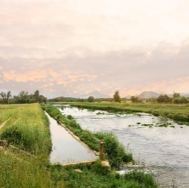
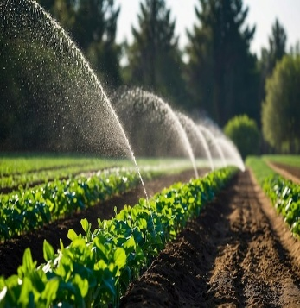
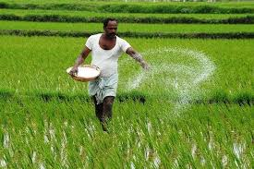
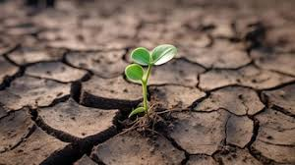
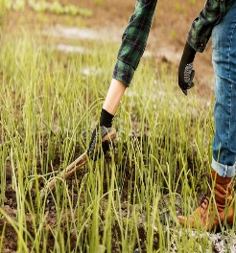
Challenge Statement
Water Wastage in Agriculture Traditional irrigation methods often overuse water, leading to resource depletion and inefficiency.
Lack of Smart Decision-Making Farmers rely on manual or outdated irrigation techniques without real-time data insights.
Unpredictable Weather Conditions Sudden rainfall or dry spells cause crop damage due to improper irrigation planning.
Lower Crop Yields & High Costs Inconsistent irrigation leads to poor crop growth, affecting productivity.

Slide 4
Concept of the solution
Real-Time Sensor Data
Collects soil moisture, temperature, and humidity to determine irrigation needs.
AI-Based Decisions
A predictive model analyzes sensor data to decide whether irrigation is required.
Weather-Aware Optimization Model
AI model predicts rainfall and adjusts irrigation accordingly to save water.
Edge AI
To enable offline machine learning predictions for real-time irrigation decisions without internet connectivity.
Interactive UI
Displays real-time data and irrigation decisions for easy monitoring.
Dynamic Irrigation Adjustment
If rain is expected, irrigation is reduced to prevent overwatering and crop damage.
Automated Control System
The system automatically manages irrigation, reducing manual effort for farmers
Water Conservation & Crop Yield
Saves water, optimizes irrigation schedules, and enhances crop health.

Slide 5
Unlike traditional systems that only use soil moisture data, our solution integrates real-time sensor data with a weather-based AI model to make smarter irrigation decisions.
Novelty & Scope of the Solution
If rain is predicted, the system reduces irrigation levels, preventing overwatering, saving water, and protecting crops from damage.
The AI learns and adapts based on past weather conditions and utilizes Edge AI & LoRa communication to enable offline ML predictions for real-time irrigation decisions.
Farmers can remotely monitor irrigation status, view real-time weather forecasts, and adjust irrigation through an interactive UI or mobile app.
The system can be extended with IoT devices, cloud storage, and machine learning analytics, making it suitable for small farms, large-scale agriculture, and even greenhouse environments.
Can be trained to optimize irrigation needs based on specific crop requirements Customizable.

Slide 6
Pros and Cons of the solution
Real-Time Monitoring
Sensors for soil moisture, temperature, and humidity, weather API for rainfall predictions.
Scalable Crop Database
Profiles for each crop with optimal growth parameters.
Automation & Convenience Reduces manual effort by automating irrigation based on AI predictions.
Offline Connection
Real-time predictions without internet dependency. Reduced latency for faster decision-making.
Efficient Water Usage
Reduces irrigation when rain is expected, saving water.
Increasing crop yield.
Cost-Effective
Saves water and energy, lowering operational costs for farmers.

Slide 7
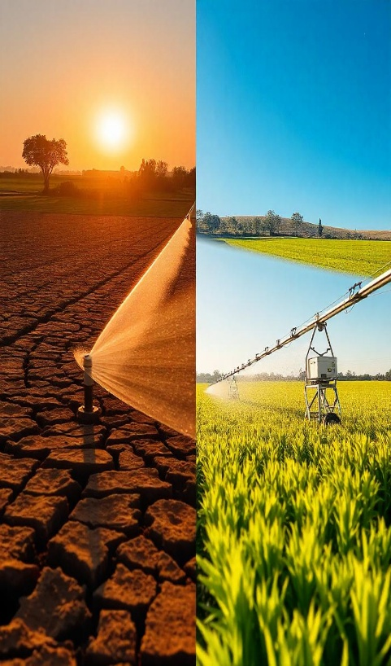
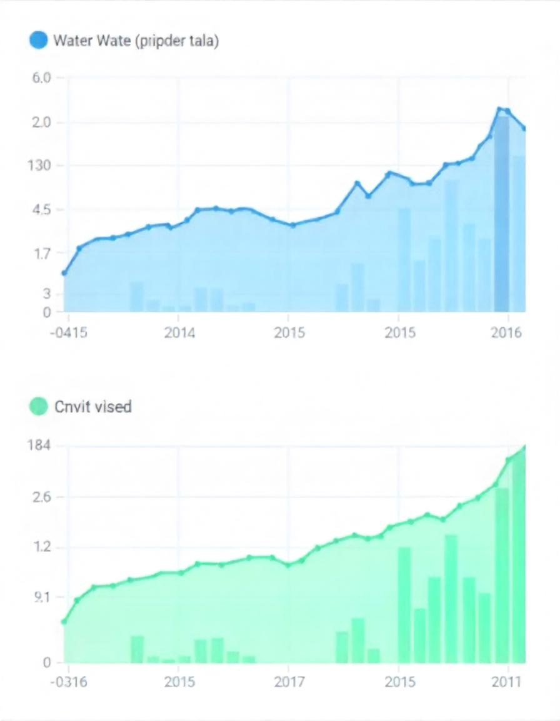
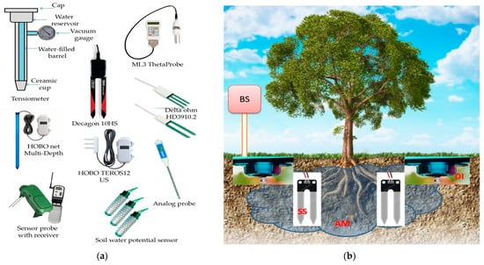
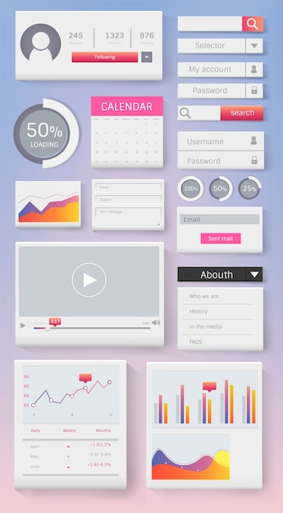
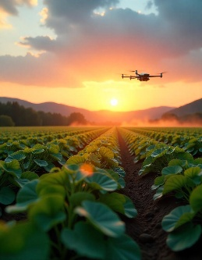
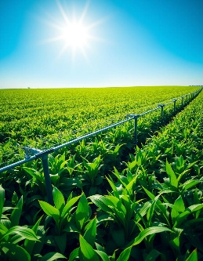
Technical Description
Traditional irrigation
Soil data-based monitoring system: (a) soil moisture measuring sensors and (b) layout of soil moisture monitoring system.
AI-based irrigation
Interactive UI dashboard
with Realtime Data
Smart farming
Comparison of traditional irrigation vs AI-powered irrigation with improved efficiency.
Line graph showing water usage over time.

Slide 8
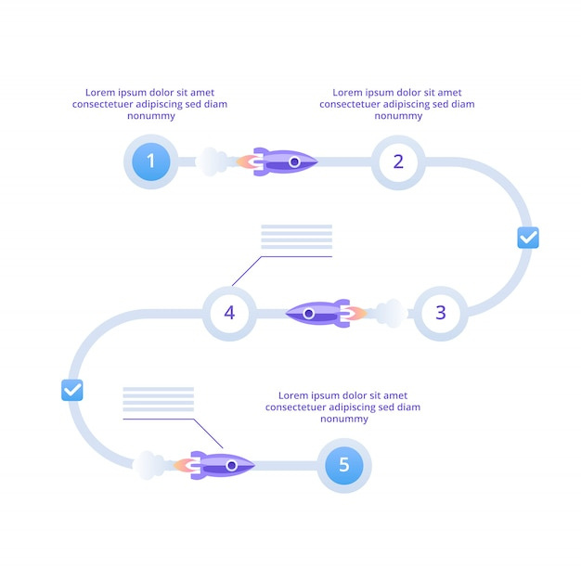
Implementation Plan
Single-crop type deployment
Deploy Irrigo in a single crop testing environment
Functional Prototype Completion
Irrigo demonstrating core functionalities
Multi-crop proto software testing
multiple crop management software
Single-crop proto launch and multi crop design
Prepare the single-crop proto for initial launch and begin design for a multi-crop system.
Multi-crop proto Deployment & Refinement
Deploy Irrigo in real-world for testing and feedback
00001

Slide 9
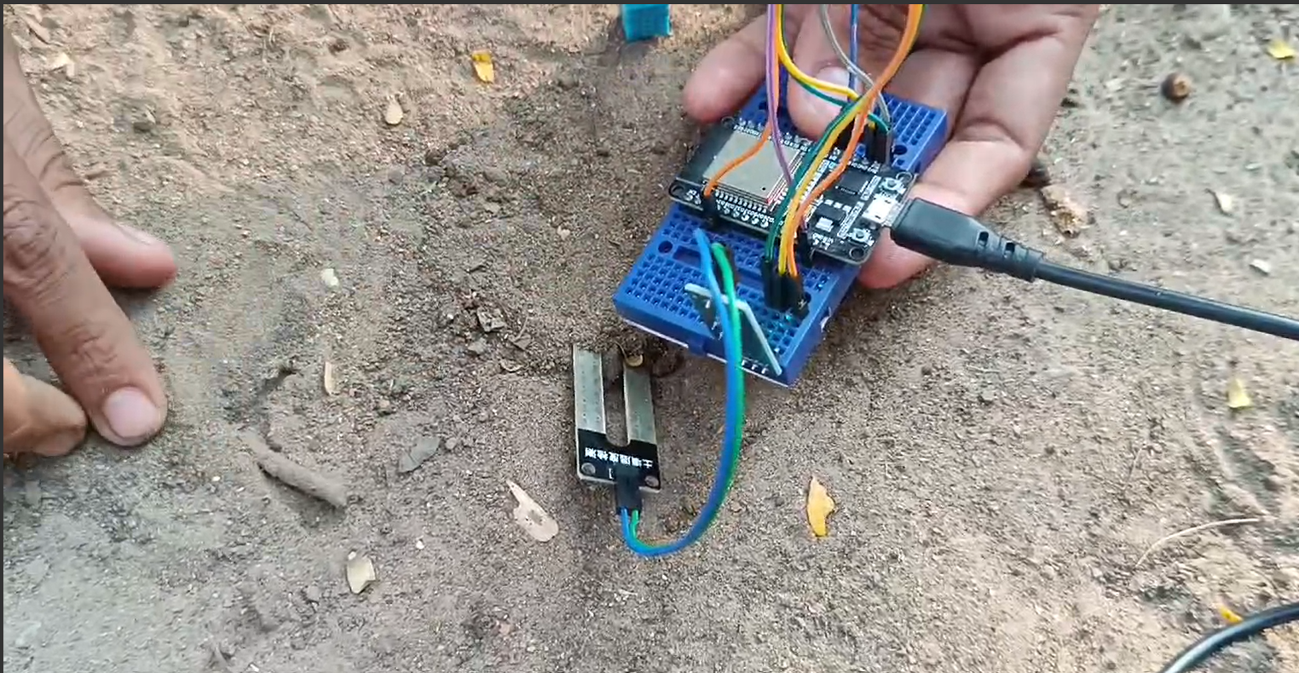
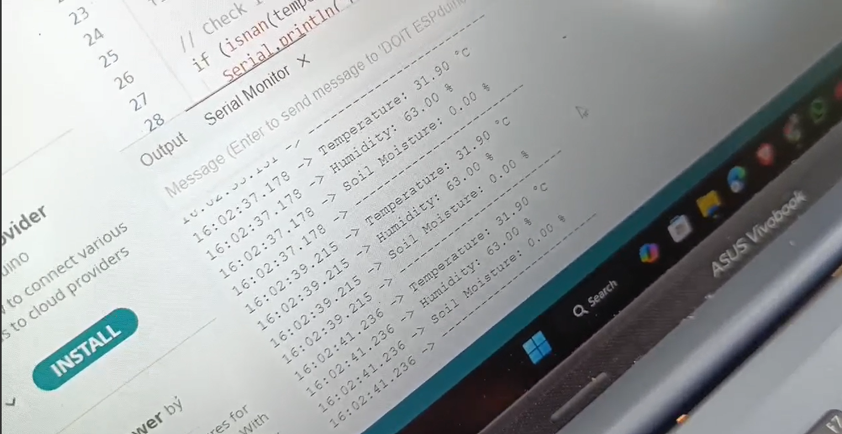
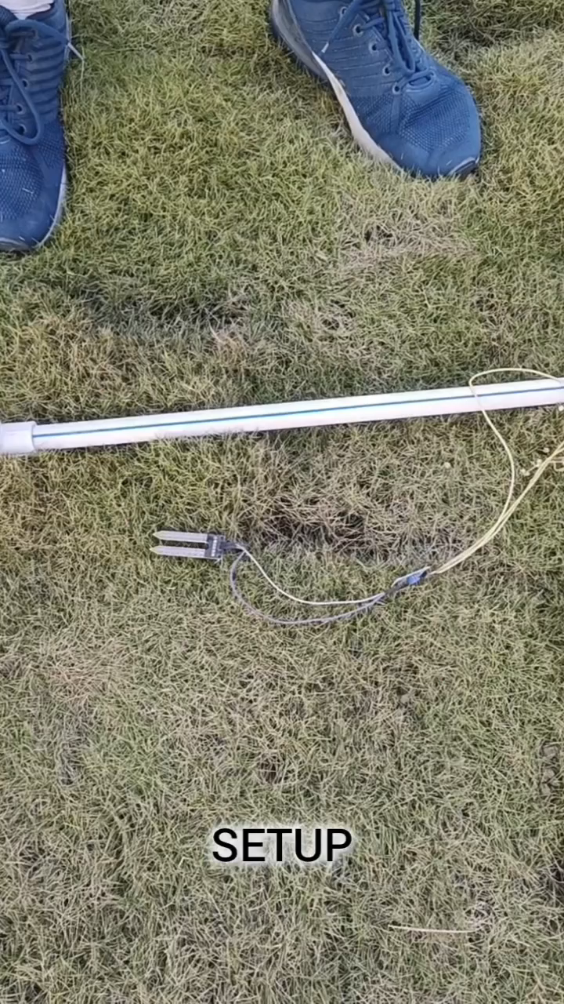
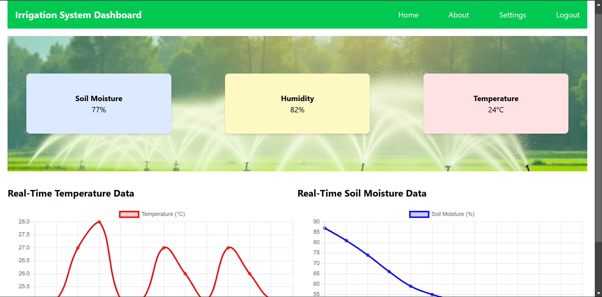
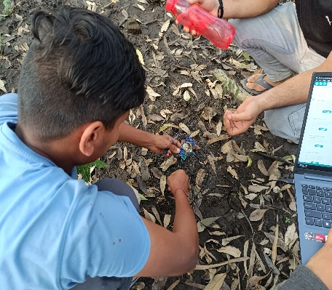
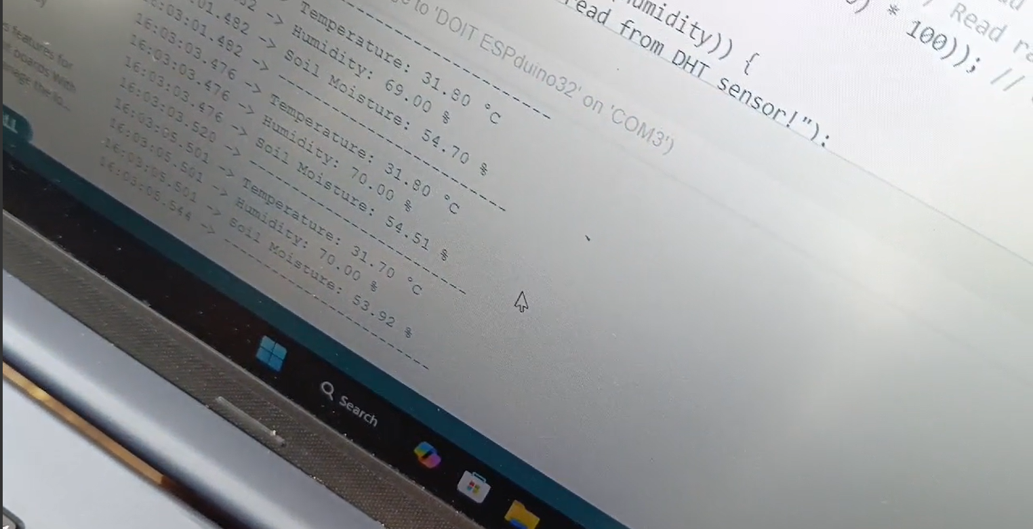
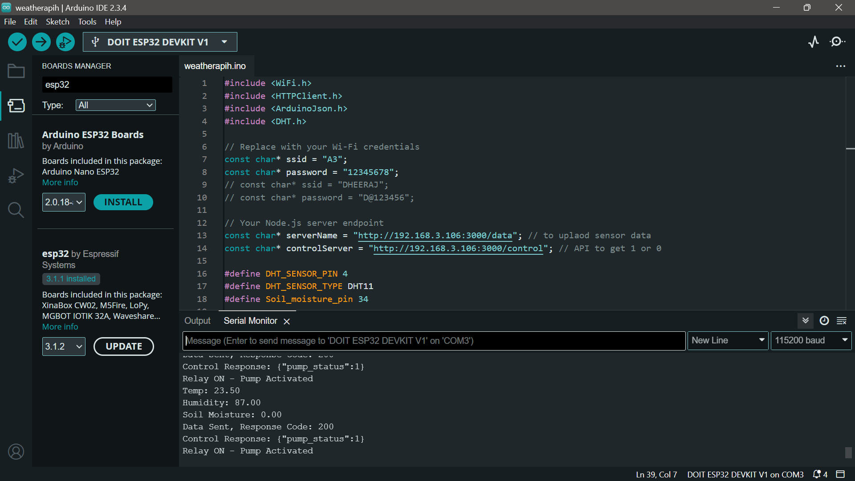
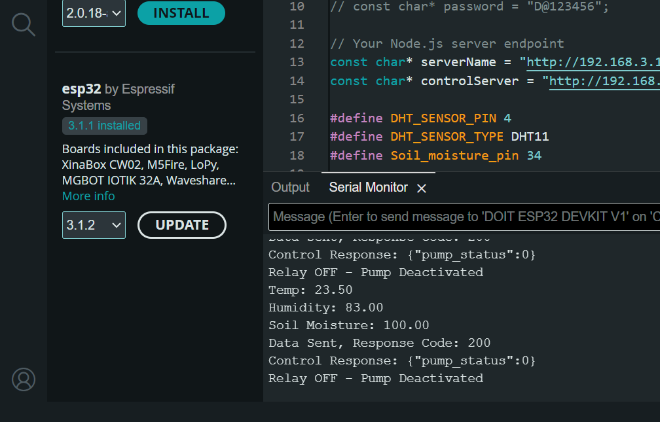
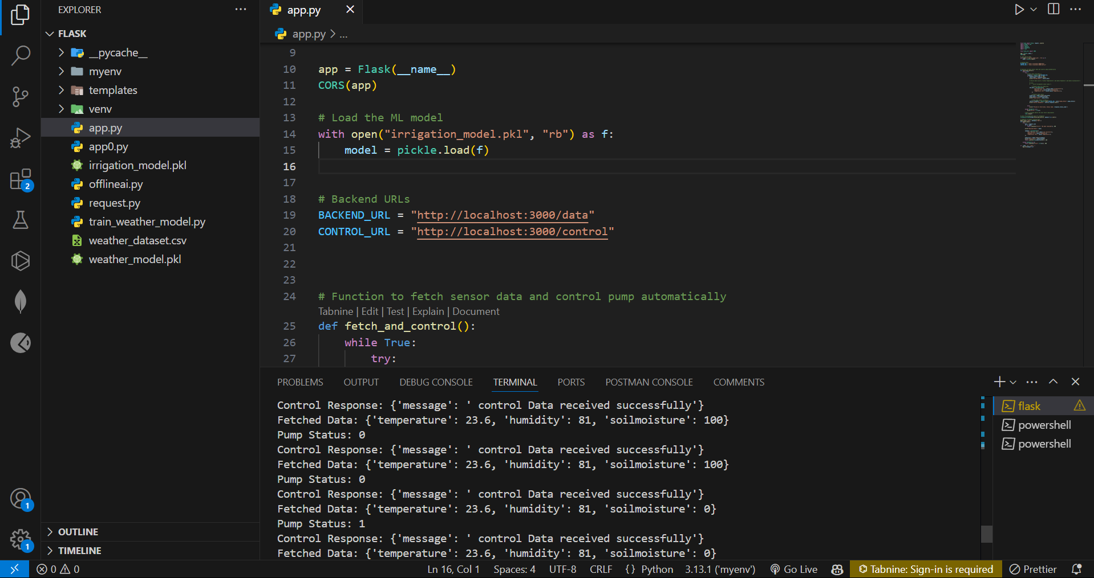
Validation / Testing / Analysis
Testing data in field
Interactive Dashboard
00001

Slide 10




Cost Estimate
Positioning for Success: Irrigo’s Place in the Indian Irrigation Automation Market
COMPONENTS | COST
Temperature & Soil Moisture sensor | ₹ 48 + ₹ 31
Relay | ₹ 32
ESP32 (Microcontroller) | ₹ 305
Others | ₹ 30
High
Irrigo
Drip Irrigation
Sprinkler System
Efficiency
Traditional Irrigation
Total Expenses : ₹ 446
Low
Affordable
Cost
High Upfront Cost
By integrating NPK sensors along with DHT11 and soil moisture sensors, farmers can monitor soil nutrient levels (Nitrogen, Phosphorus, Potassium) in real-time, optimizing fertilization for better crop yields. This combination enables more precise, data-driven decisions on soil health, resulting in healthier crops, improved productivity, and reduced fertilizer wastage, promoting sustainable agriculture.
00001

Slide 11
Assumptions
The cost estimates are based on current market prices of DHT11, soil moisture, and NPK sensors for small-scale agricultural use.
Industry-grade sensors may vary in price depending on durability, accuracy, and brand.
This project is designed with a focus on a single crop type for demonstration purposes.
Soil moisture levels are assumed to be consistent across a specific location, which may not account for micro-variations.
Sensor placement and environmental factors are considered ideal for accurate data collection.
Data accuracy is assumed to be consistent across various environmental conditions for sensor readings.
The IoT system will be compatible with common microcontrollers (e.g., ESP32).

Slide 12
References
Lakhiar, I. A., Yan, H., Zhang, C., Wang, G., He, B., Hao, B., Han, Y., Wang, B., Bao, R., Syed, T. N., Chauhdary, J. N., & Rakibuzzaman, M. (2024). A review of precision irrigation water-saving technology under changing climate for enhancing water use efficiency, crop yield, and environmental footprints. Agriculture, 14(7), 1141. https://doi.org/10.3390/agriculture14071141
https://www.researchgate.net/publication/319501869_Automated_Irrigation_System_using_Weather_Prediction_for_Efficient_Usage_of_Water_Resources
00001

Slide 13
Thank You
00001

